Slide 1
COVID-19 Vaccination and Infection Rate
Junhao (David) Zhang

Slide 2
Problem
Question: How does vaccination in a community affect infection rates over time?
The effectiveness of vaccines for individuals is a biological/medical research question.
This project focuses on the social aspect.
Vaccinated individuals might be at lower risk even before vaccination.
Vaccinated individuals might help protect unvaccinated individuals.

Slide 3
Problem
Question: How does vaccination in a community affect infection rates over time?
The effectiveness of vaccines for individuals is a biological/medical research question.
This project focuses on the social aspect.
Vaccinated individuals might be at lower risk even before vaccination.
Vaccinated individuals might help protect unvaccinated individuals.

Slide 4
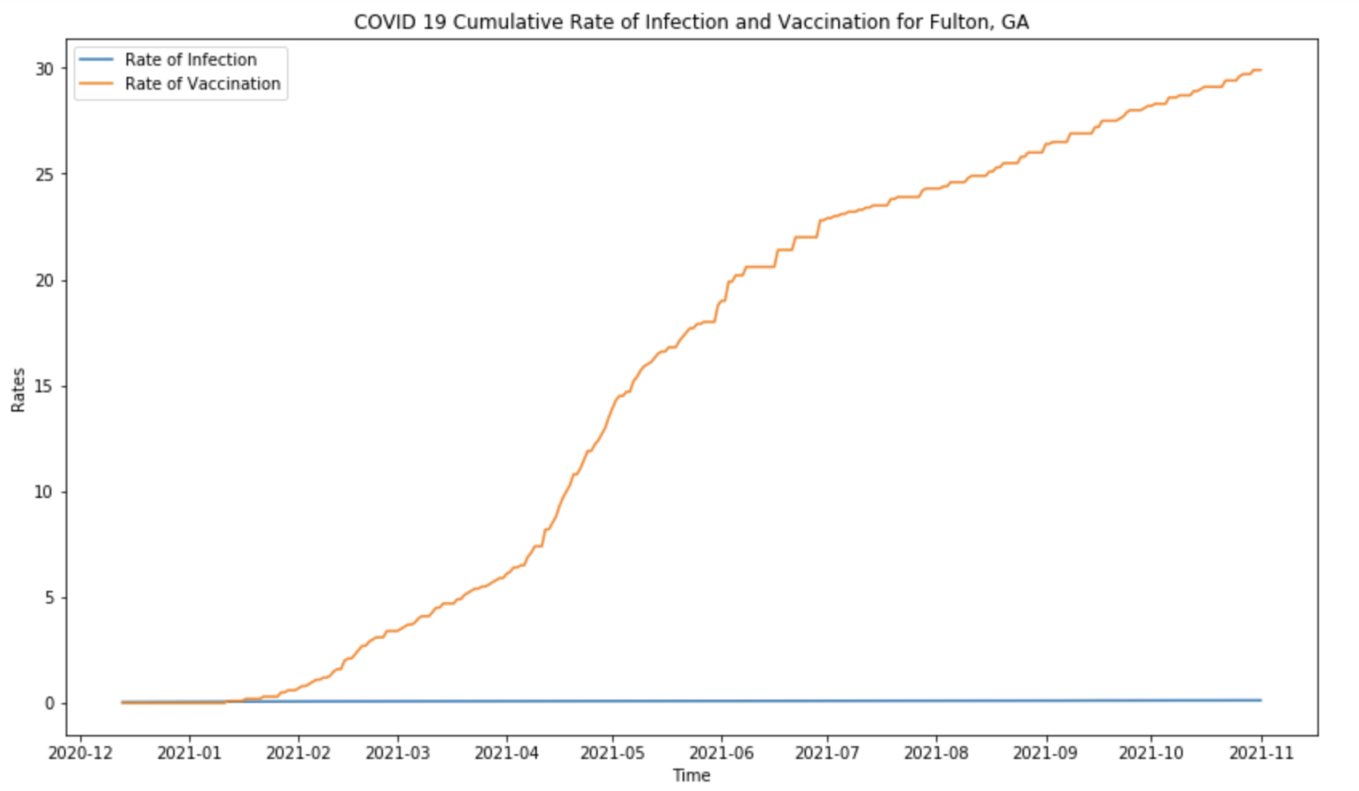
Data Overview
Daily COVID-19 confirmed cases by county
Daily COVID-19 vaccination by county
Focus on Fulton, GA

Slide 5
Data Overview
Daily COVID-19 confirmed cases by county
Daily COVID-19 vaccination by county
Focus on Fulton, GA

Slide 6
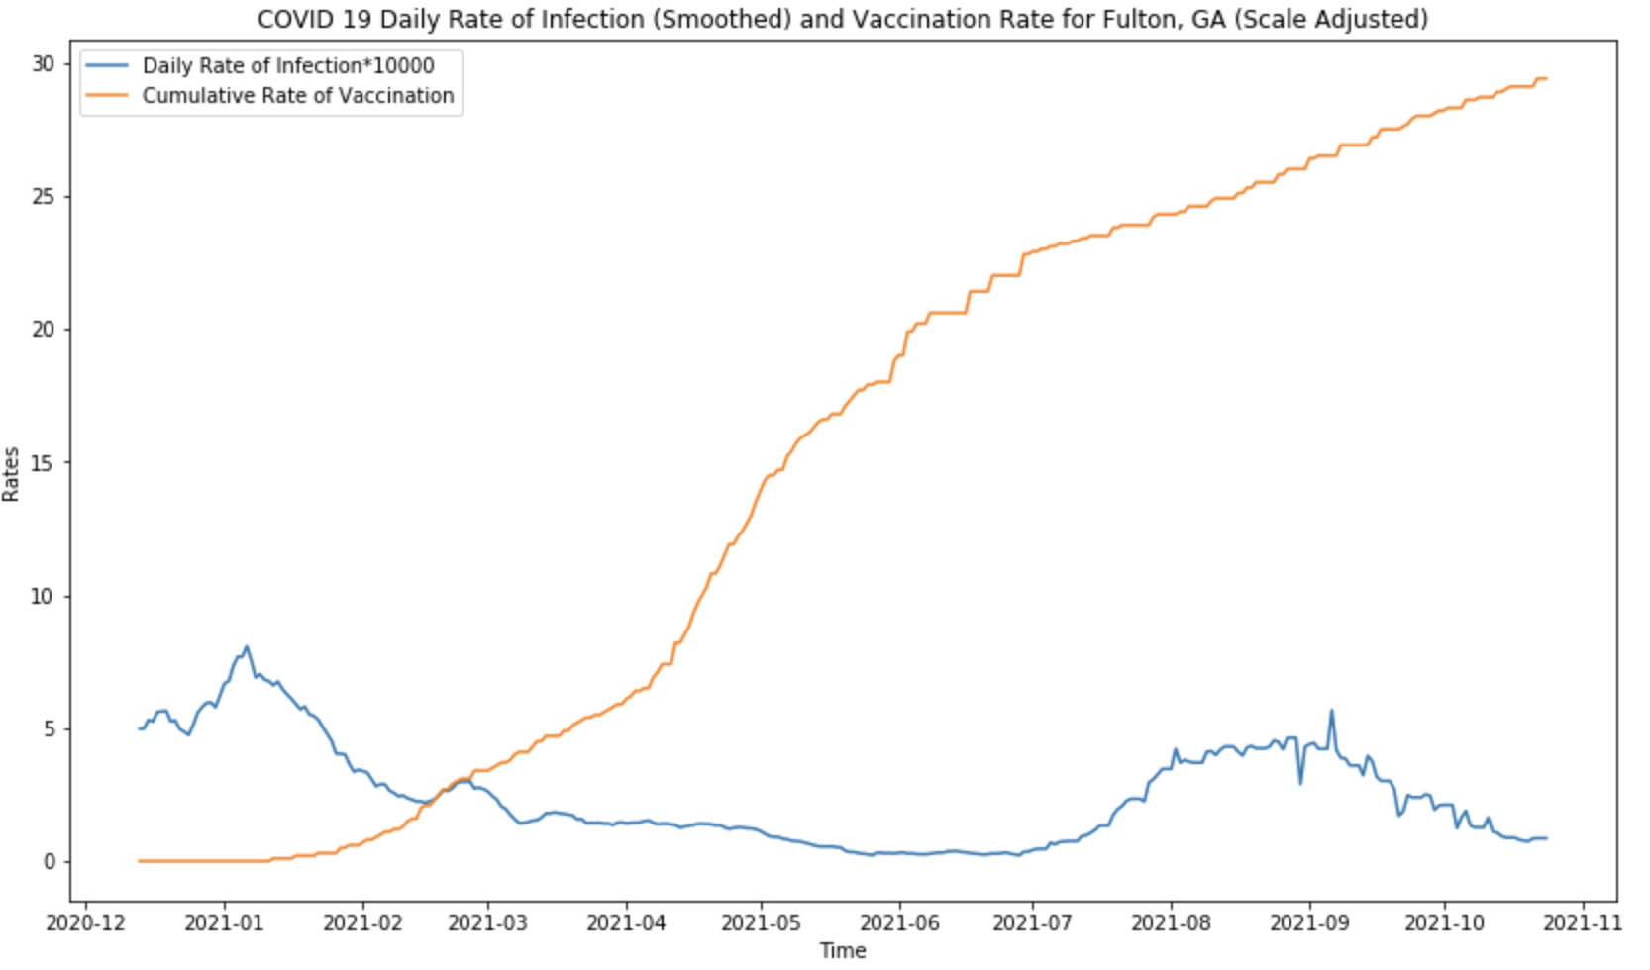
Vaccination Rate and Daily Infection Rate

Slide 7
Vaccination Rate and Daily Infection Rate

Slide 8
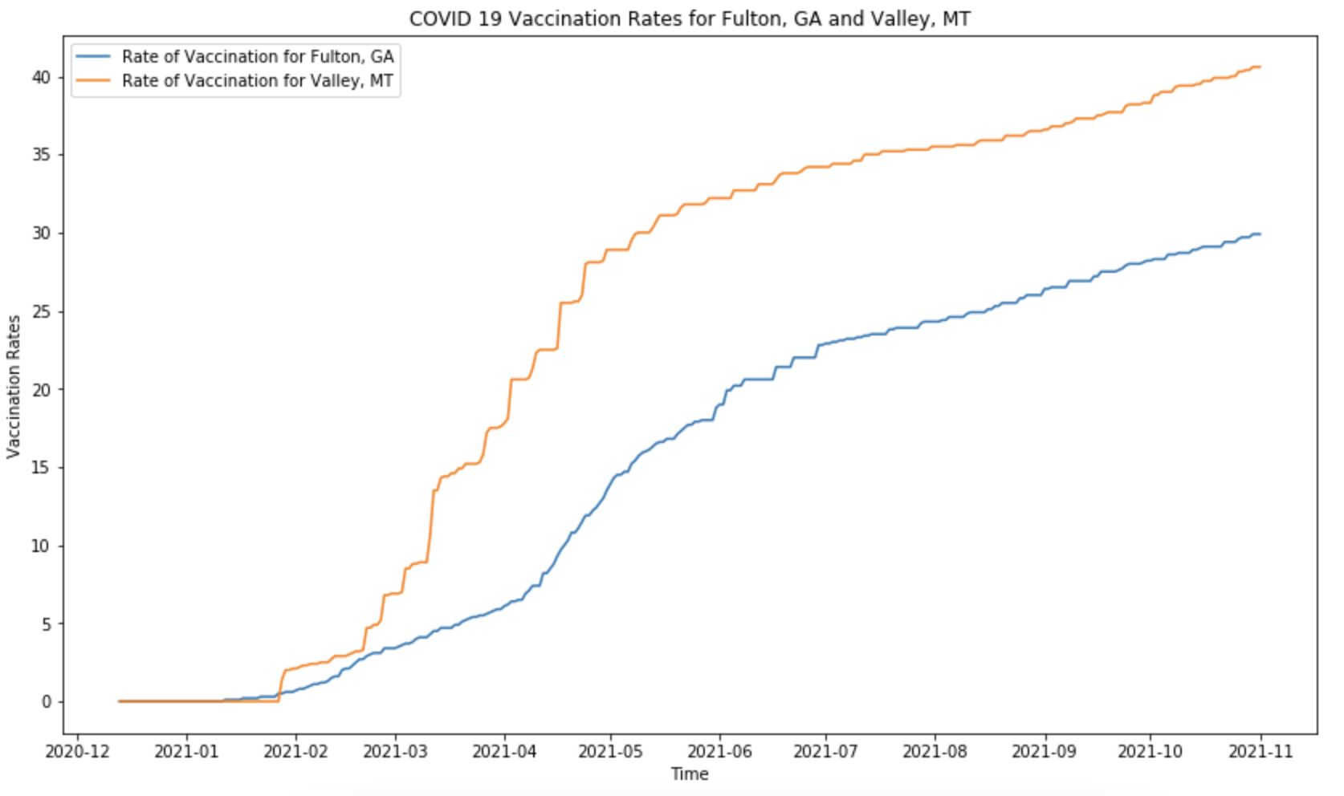
Fulton vs. Valley: Vaccination Rate

Slide 9
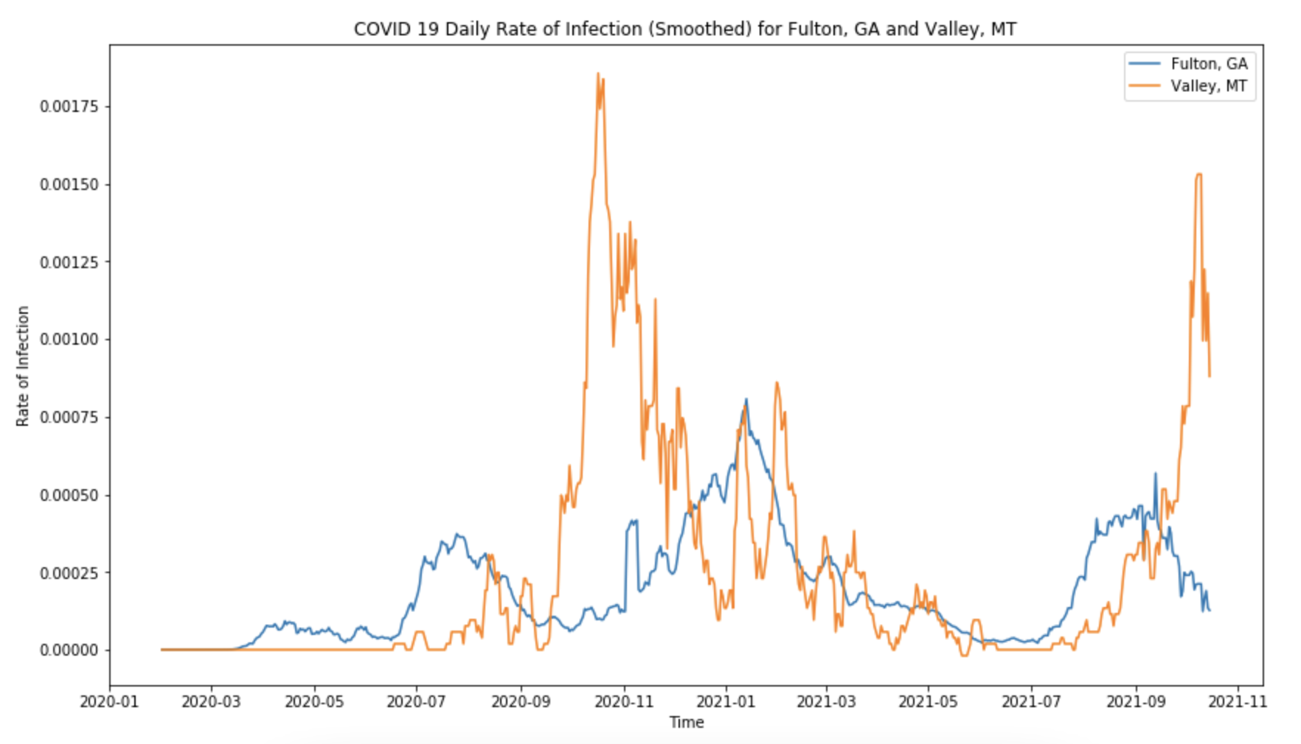
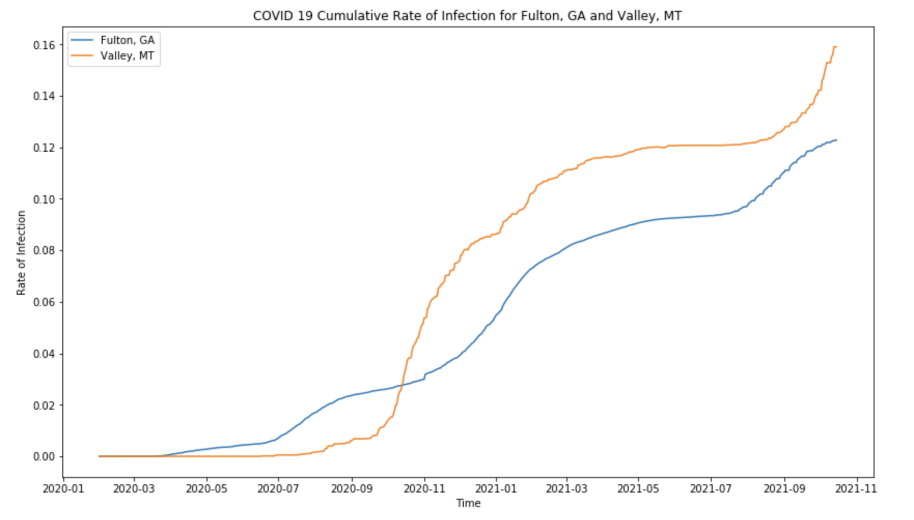
Fulton vs. Valley: Infection Rate

Slide 10
Conclusion
Vaccination in the community does not strictly decrease infection rate.
Vaccinated people may have been following CDC guidelines before vaccination.
Limitations
Only compare two counties.
Vaccination impact may increase significantly with higher vaccination rates.

Slide 11
Conclusion
Vaccination in the community does not strictly decrease infection rate.
Vaccinated people may have been following CDC guidelines before vaccination.
Limitations
Only compare two counties.
Vaccination impact may increase significantly with higher vaccination rates.

Slide 12
Thank you!

